Slide 1
Software Testing

Slide 2
Agenda
Traditional vs. Modern Testing
Formal Test Case Management
Visual Studio Test Manager
Manual Testing Demo with Test Manager 2012

Slide 3
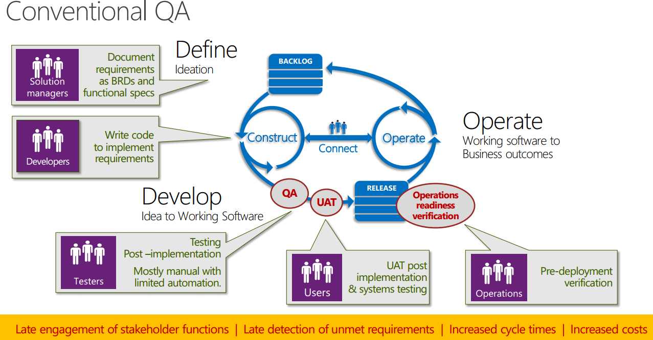

Slide 4
The problem
When a tester finds a bug it is very common practise for the tester to repeat the exact same steps often two or three times to verify the bug and prove it is reproducible
This consumes significant amounts of a testers time and often involves repeating large numbers of steps

Slide 5
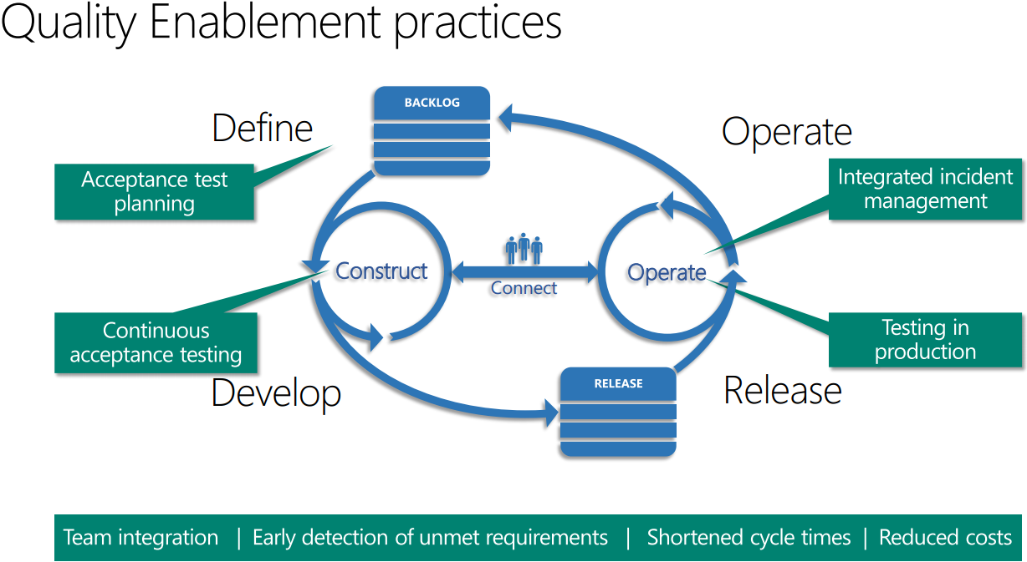

Slide 6
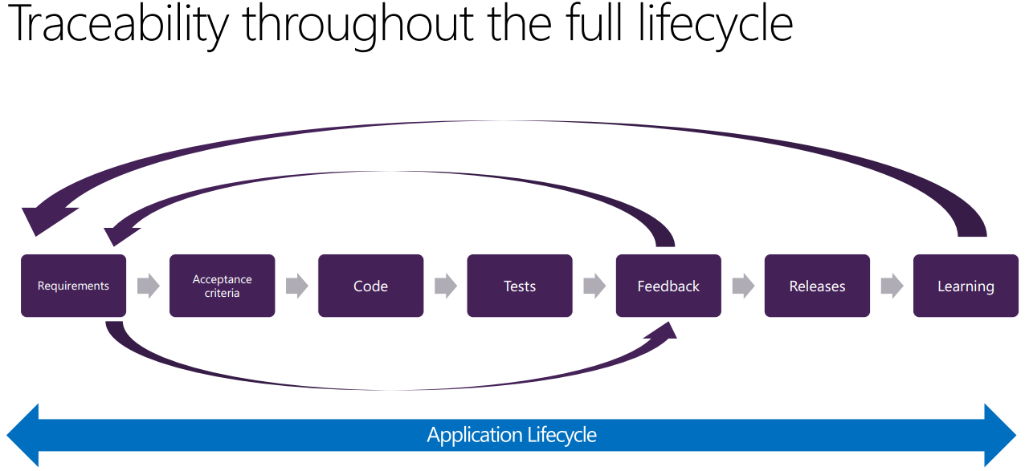

Slide 7
Formal Test Case Management

Slide 8
Test Strategy
Iteration Planning
Iteration Execution
Add stories to plan
Define acceptance
Select regression tests
Define Test Settings
Author tests
Run tests
File bugs
Verify fixes
Automate tests
Release Planning
Release Iteration
Set Test Strategy
Define Done, Done
Establish Environments
Review configurations
Create plans
Regression testing
Release doneness testing
Release sign off
Multiple Iterations

Slide 9
Test Strategy
Iteration 1
Iteration 2
Release Iteration
Feature A
Feature A
Feature B
Feature C
Feature D
Unit
Testing
Manual
Testing
Regression
Testing
Performance
Testing

Slide 10
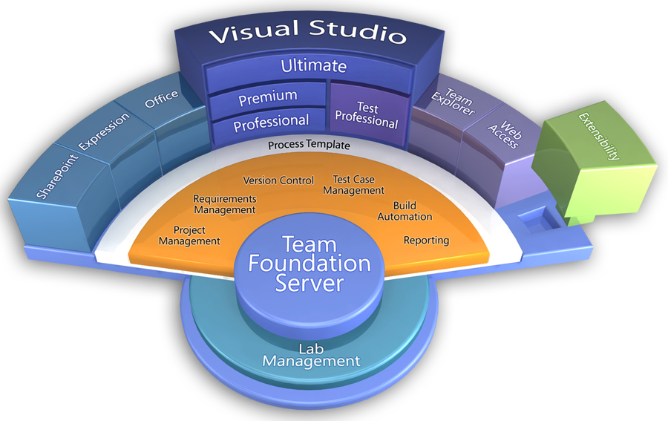
Visual Studio 2012

Slide 11
Visual Studio 2008 Test Types
Unit Test
Database Unit Test
Web Test
Load Test
Manual Test (Text / Word)
Generic Test
Ordered Test

Slide 12
Visual Studio 2012 Test Types
Unit Test
Database Unit Test
Web Performance Test
Load Test
Manual Test (Test Case)
Generic Test
Ordered Test
Coded UI Test

Slide 13
Open Test Manager 2013

Slide 14
Choose Project to Test

Slide 15
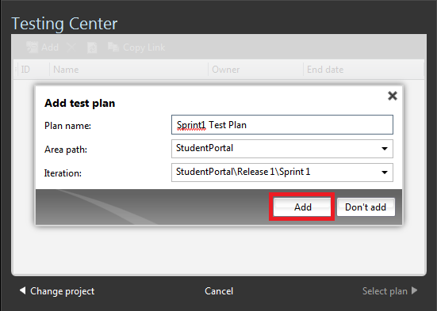
Creating a Test Plan for Sprint 1

Slide 16
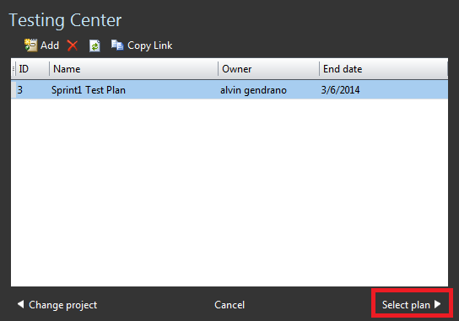
Choosing the Test Plan to work with

Slide 17
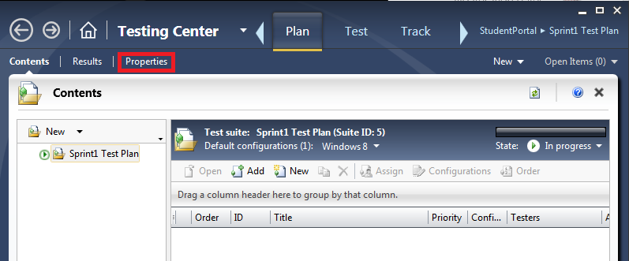
Bring out the Test Plan Properties

Slide 18
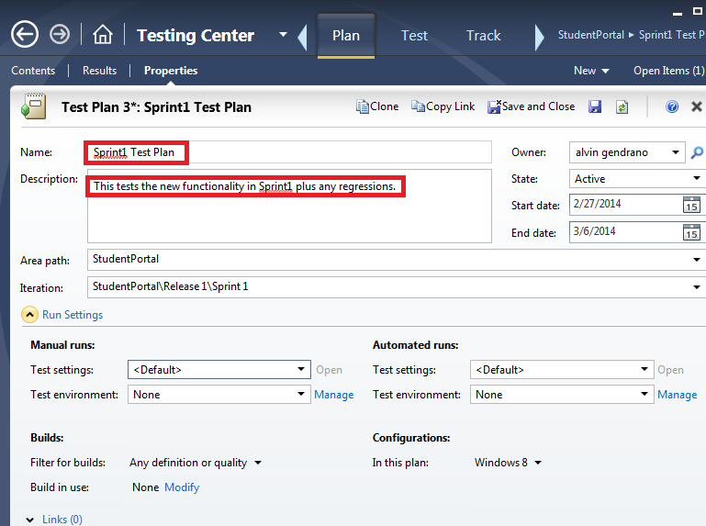
Fill out Test Plan Properties

Slide 19
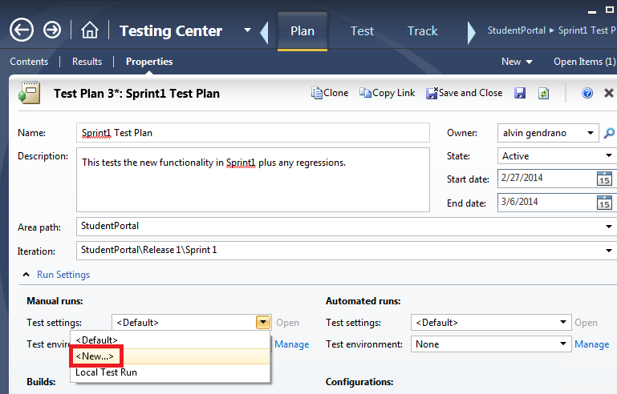
Create New Test Settings

Slide 20
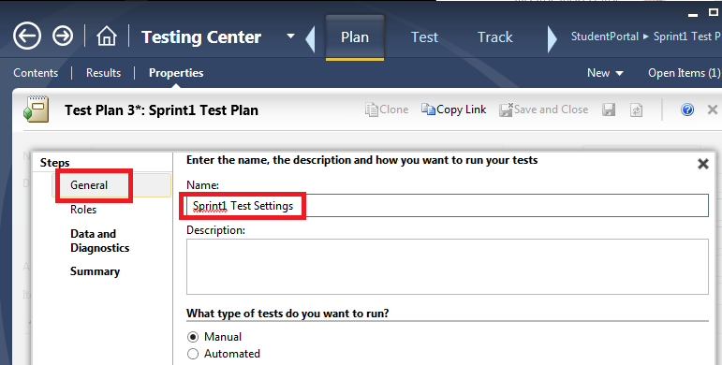
Define New Test Settings: General

Slide 21
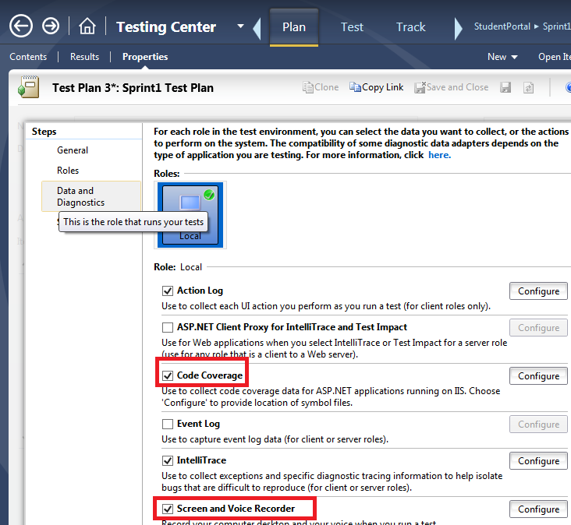
Define Diagnostics to Collect

Slide 22
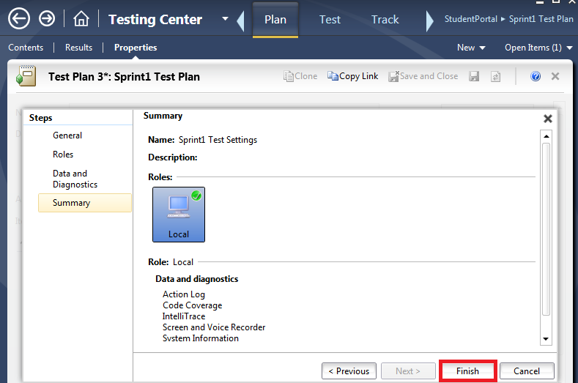
Test Setting Summary and Save

Slide 23
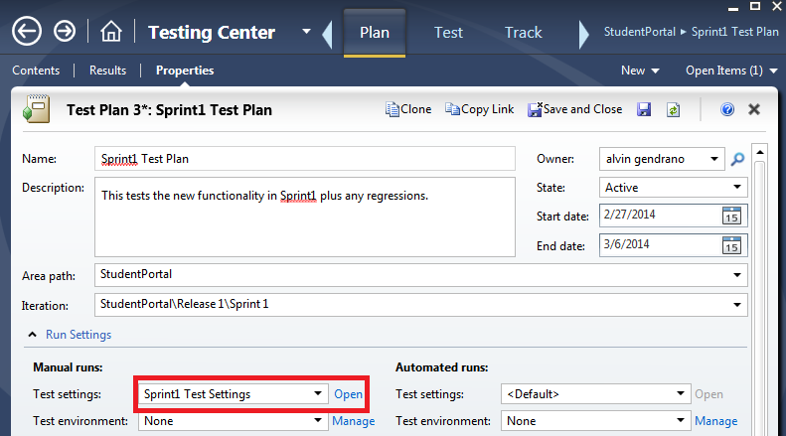

Slide 24
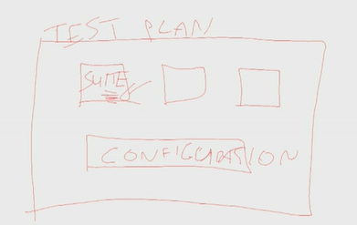

Slide 25
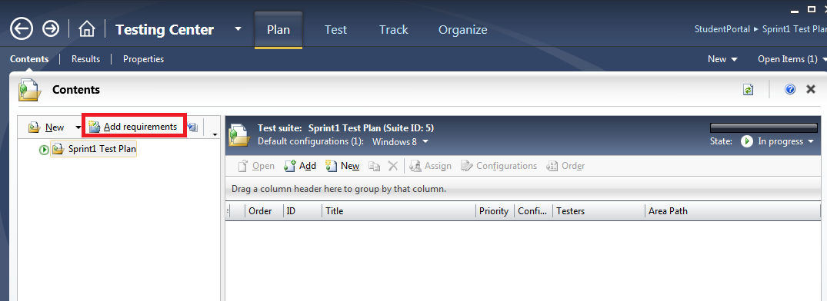
Add Test Suites Based on Requirements/Backlog

Slide 26
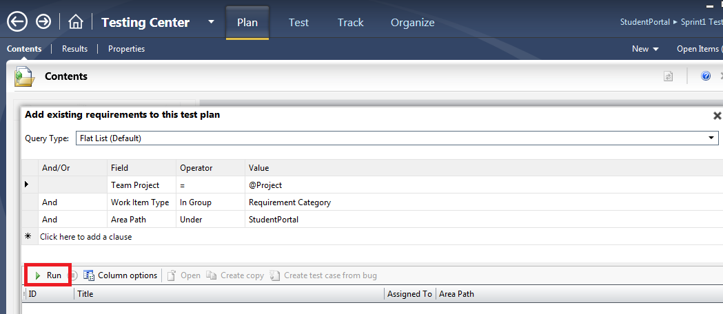
Run the Requirements Query – Click Run

Slide 27
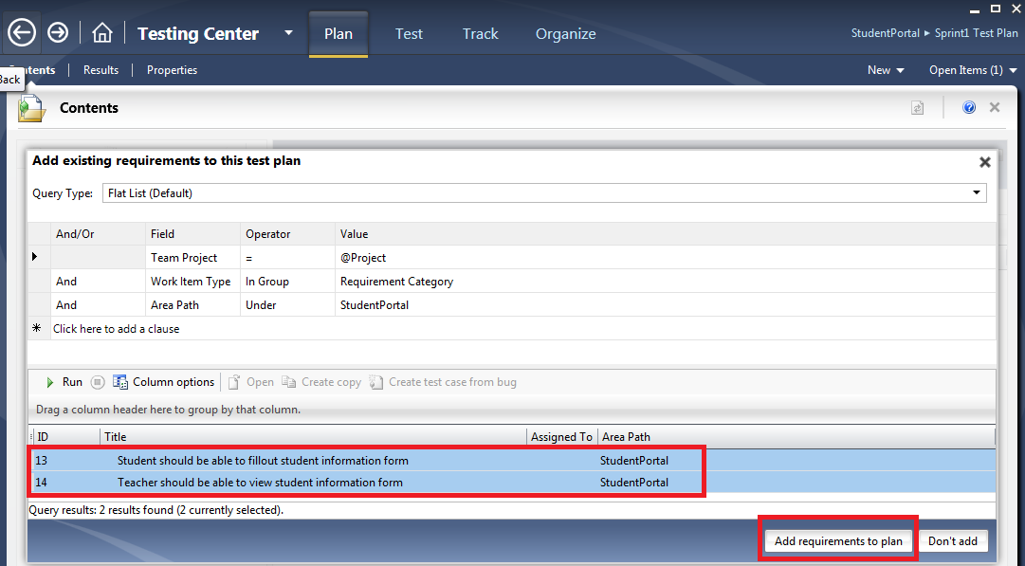
Choose requirements to Add

Slide 28
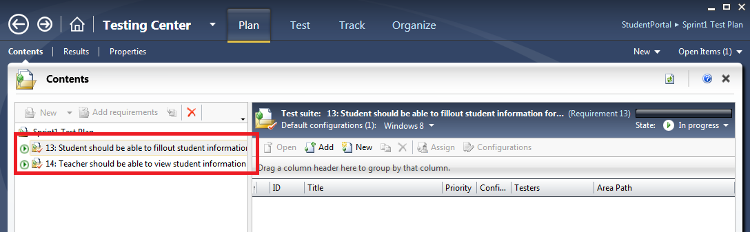
Resulting Test Suites

Slide 29
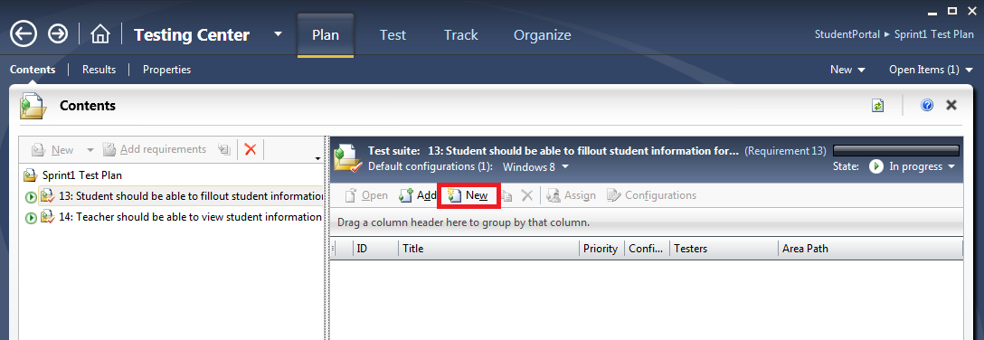
Adding Test Cases to Your Test Suites

Slide 30
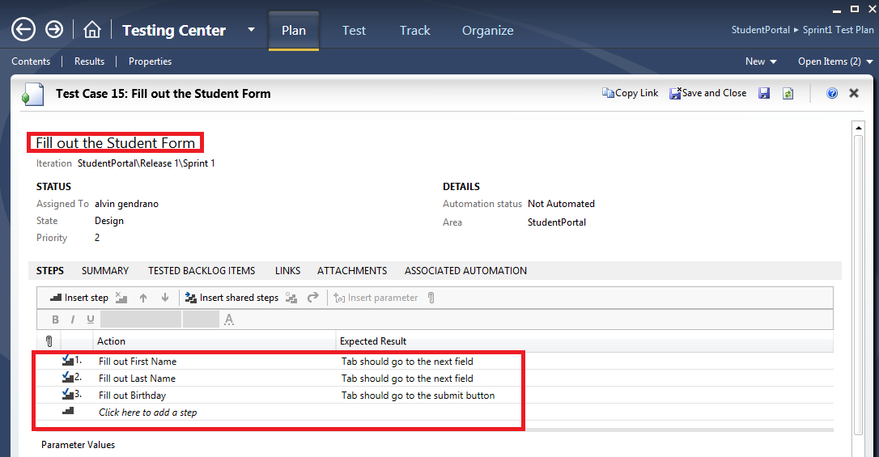
Adding Test Steps

Slide 31
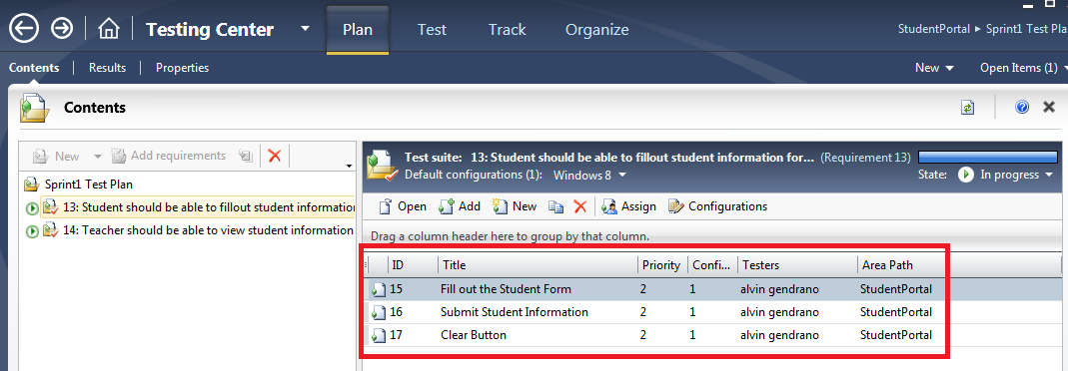
Test Cases Added

Slide 32
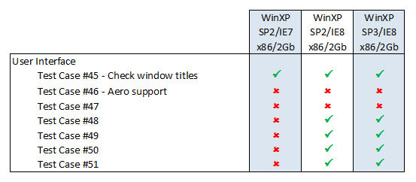
Tracking different configurations
Traditional approach
Test cases mapped to configurations in a matrix

Slide 33
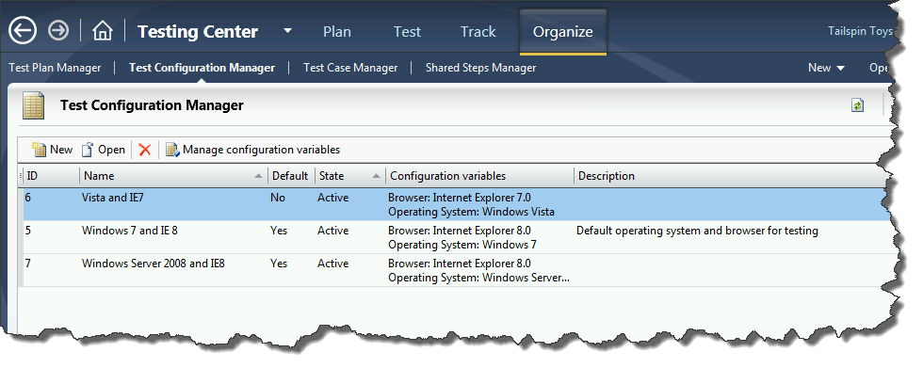
Configurations
To manage your configurations, choose Organize in the menu then choose Test Configuration Manager

Slide 34
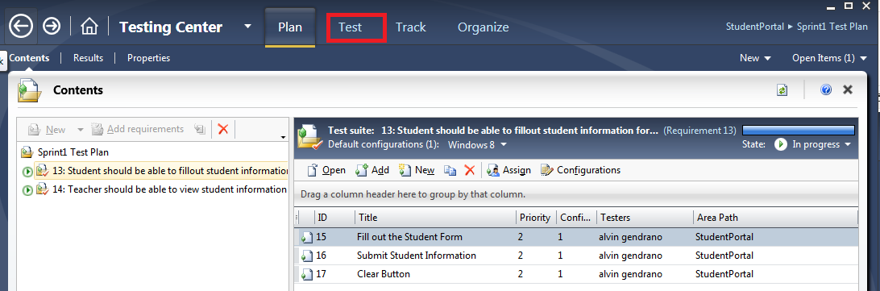
Running the Manual Test

Slide 35
Run Tests

Slide 36
Test Case – Fast Forward
The idea behind fast forwarding test cases is as follows.
When a tester runs a manual test, the UI actions are recorded in the background
When the tester wants to re-run the test case to verify the bug, the tester can choose to automatically rerun as many of the recorded steps as necessary to take them quickly to the area they are most interested in
Action recordings are attached to the test case allowing automated playback in the future

Slide 37
Perform Exploratory Testing

Slide 38
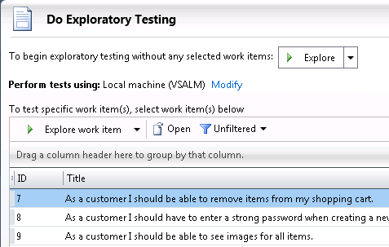
Exploratory Testing in MTM
When you want to commence an exploratory testing session you have the option to link any results to a particular requirement or not.
Do exploratory testing without linking to a requirement
Do exploratory testing and link to selected requirement

